Slide 1
Optimizing XFEL experiment methodology through start-to-end simulations
Juncheng E (Jun)
SPB/SFX Group
PBS meeting
March 9th, 2021
juncheng.e@xfel.eu
Notes:
[:20]

Slide 2
The case for modelling at XFEL facilities
Within a single experimental shift, a large amount of time may be spent on setup and/or optimization of conditions (even for established operating modes)
The integration of these technical advances into scientific programs would be greatly accelerated by a modelling tool that allowed for quantitative assessment of the impact on scientific programs of facility improvements.
Predicting appropriate parameter ranges for potentially complex experiments can also benefit use of beam time and hardware development
Even a modest improvement in use of beam can have a significant impact on science outputs — particularly at high repetition rate facilities where sufficient data may be collected in a short time at the “right” conditions
Notes:
[02:10]
The experimental time is quite limited to optimize the setups. We would like to have a better or efficient way to optimize the experiments.
There are also chances that we want to integrate some advanced techniques into our scientific programs, like a new mirror, new lens or a new camera. It would really great if we could model its performance and assess its impact on the scientific programs. We can answer the question
How much improvement the integration could bring to us.
What are the optimal parameters
In order to answer the question, we would like to be able to predict appropriate parameter ranges. Because we can save some beam time by doing simulations and give out optimal parameter ranges for hardware development.
Especially at high repetition rate facilities, we can get a bunch of benefits if we can get the “right” conditions. We think A good modeling tool can get us closer to the “right” conditions

Slide 3
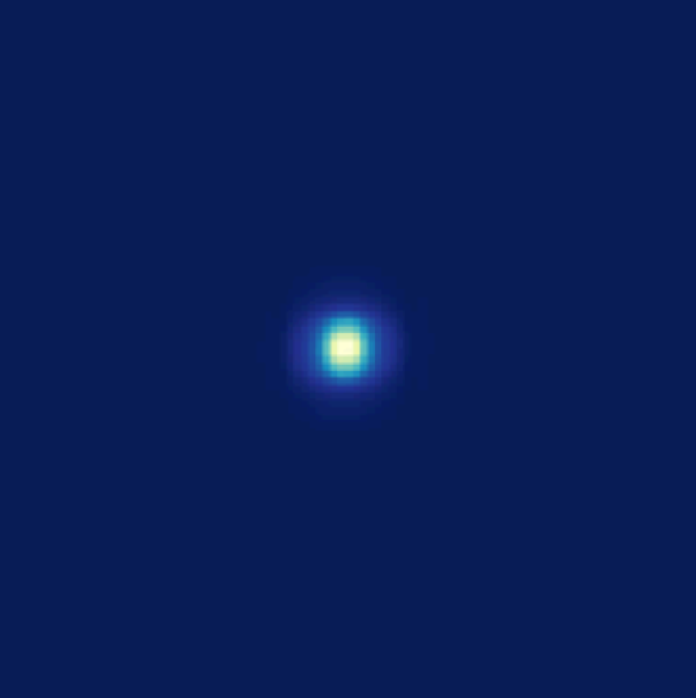
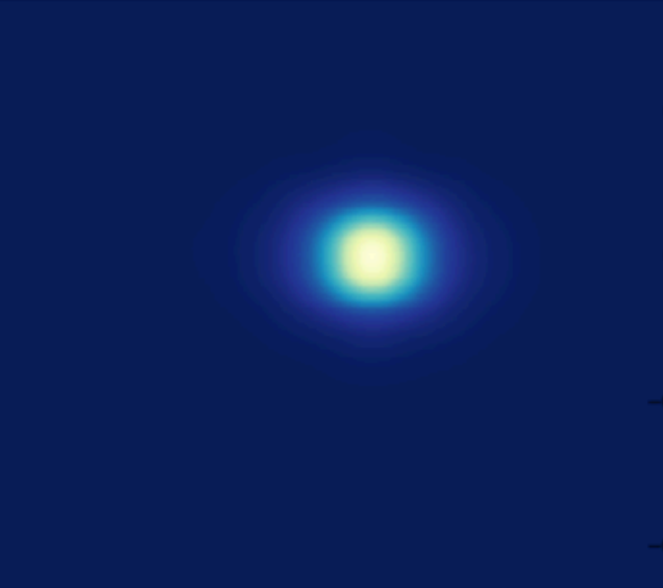
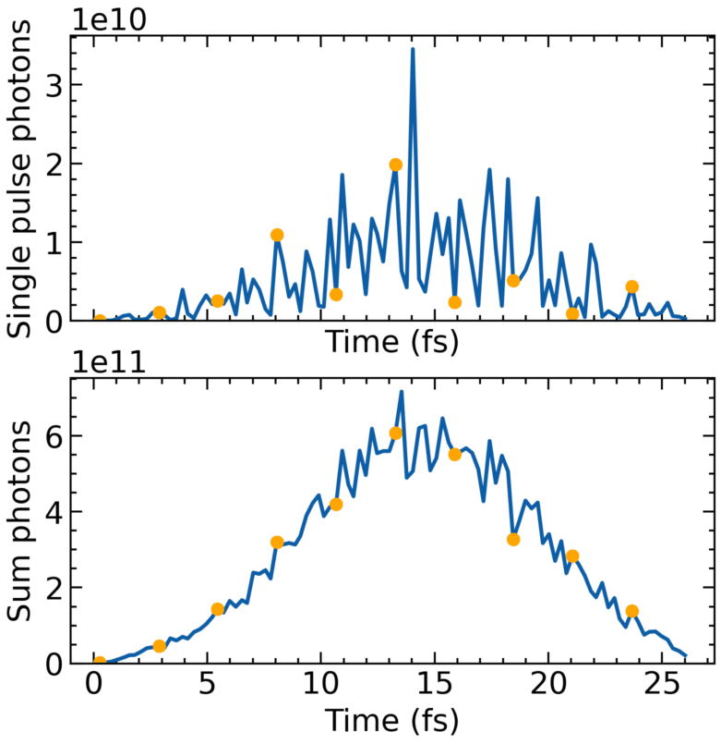
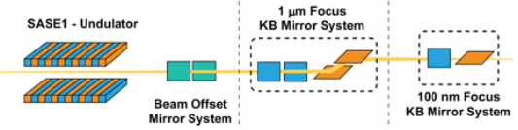
What makes a successful experiment?
Photon source
Photon propagation
How should the accelerator be configured to produce the “best” pulses?
How do FEL components and configurations degrade, or enhance, experimental results?
e.g. Heat load influence on asymmetric crystal optics
How do real pulses (e.g. SASE pulses with fluctuations), instead of idealised pulses, propagating through the instrument interact with the optics?
Mills, G., Bean, R. & Mancuso, A. P. Applied Sciences 10, 3642 (2020).
Notes:
[00:55]
Then we would ask what are the “right” conditions, what makes a successful experiment, what parameters we would like to investigate and optimize?
How should the accelerator be configured to produce the “best” pulses? What is the definition of best pulses?
Regarding the heat influence on asymmetric crystal optics, how large will this influence be like?

Slide 4
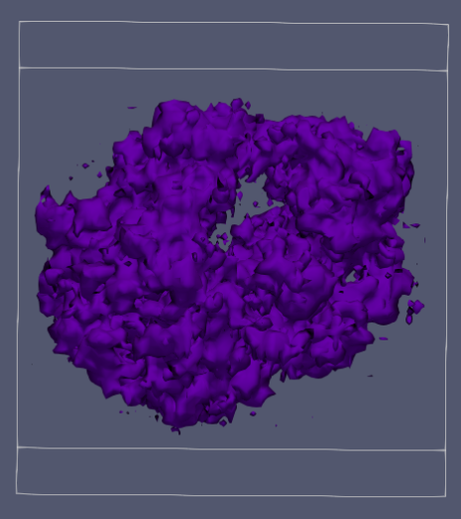
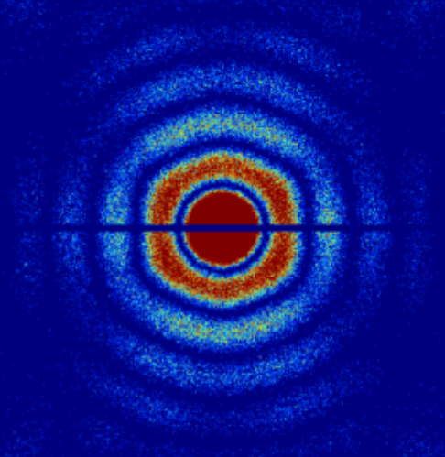
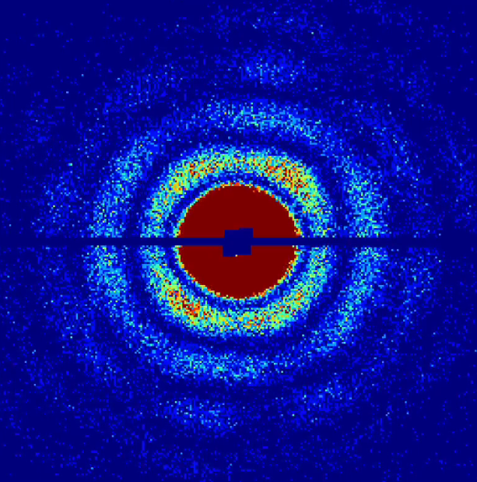
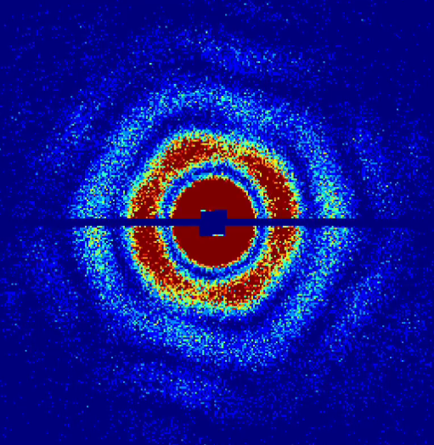
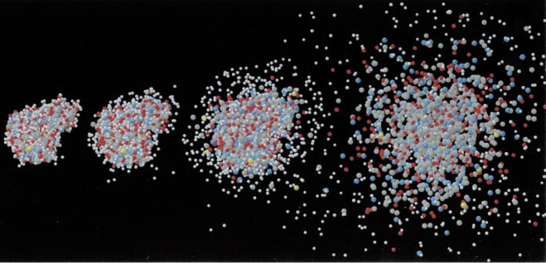
What makes a successful experiment?
Photon source
Photon propagation
Photon-Matter interaction
Signal generation
What will happen during the interaction?
Does that influence what can be measured on the detector?
Neutze, R., Wouts, R., van der Spoel, D., Weckert, E. & Hajdu, Nature 406, 752–757 (2000).
Yoon, C. H. et al. Scientific Reports 6, 24791 (2016).
Fortmann-Grote, C. et al. IUCrJ 4, 560–568 (2017).
Notes:
4. [0:30]
The propagated beam will meet the sample. The photon-mattter interaction and scattering process will start almost at the same time. Here we would like to ask what will happen during the interaction. If there is radiation damage, will the radiation damage incfluence what can be measured on the detector?

Slide 5
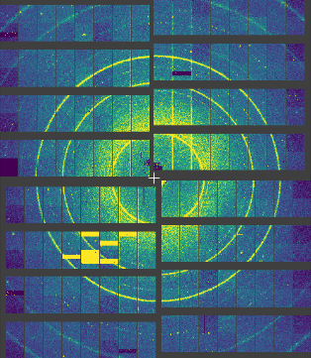
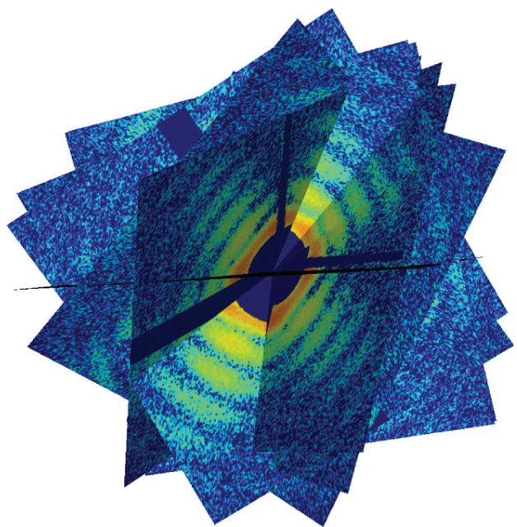
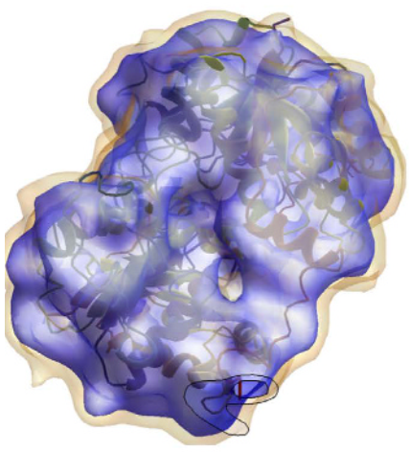
What makes a successful experiment?
Photon source
Photon propagation
Photon-Matter interaction
Detector response
Signal generation
How much data is enough?
What (detrimental) effects can be ameliorated by simply collecting more data?
What’s the smallest particle size practically visible in a single particle imaging experiment
Data analysis
Neutze, R., Wouts, R., van der Spoel, D., Weckert, E. & Hajdu, Nature 406, 752–757 (2000).
Ekeberg, T. et al. Physical review letters 114, 098102 (2015).
Yoon, C. H. et al. Scientific Reports 6, 24791 (2016).
Fortmann-Grote, C. et al. IUCrJ 4, 560–568 (2017).
Notes:
5. [0:46]
Then the scattered beam will be captured by the detector. The data will be analyzed through some established analysis methodology. Take single particle imaging as an example, the analysis includes orientation and phase reconstrctions. We will ask these questions.

Slide 6
What makes a successful experiment?
Photon source
Photon propagation
Photon-Matter interaction
Detector response
Signal generation
How should the accelerator be configured to produce the “best” pulses?
What’s the definition of the “best” pulses?
Data analysis
Neutze, R., Wouts, R., van der Spoel, D., Weckert, E. & Hajdu, Nature 406, 752–757 (2000).
Ekeberg, T. et al. Physical review letters 114, 098102 (2015).
Yoon, C. H. et al. Scientific Reports 6, 24791 (2016).
Fortmann-Grote, C. et al. IUCrJ 4, 560–568 (2017).
Notes:
6. [0:25]
Then let's look back to our first questions: how should... Here we can have a bold imagination to build a feedback loop using the analysis results to optimize the experimental parameters. It's not easy, but we think it's still possible.

Slide 7
What parameters can be understood/optimized through Start-to-end simulations
Photon source
Pulse duration, repetition rate
Pulse (temporal and spatial) profile shape
Pulse energy
Beam wavelength
Beamline optics
Optics (mirror, lens, monochromator, ...) parameters (profile, distance)
Beam wavelength
Sample
Sample environment (water layer, ...)
Detector
Geometry (detector distance)
And more…
Data analysis methodology
Validate data analysis methodology
Estimate required amount of data/resolution limitation/…
almost unlimited possibility

Slide 8
Benefits of Start-to-End platforms
An efficient, high-fidelity and simple-to-use simulation platform will allow:
Narrowing the range of parameter space, which any given experiment needs to explore, to observe phenomena of scientific interest. This includes to quickly and efficiently explore parameter spaces that may be experimentally challenging to explore.
Investigating the feasibility of measuring signal in a given experiment (with some degree of confidence ).
Informing optimal design of instrumentation for future experiment stations or configurations.
Probing physical understanding of experimental observations where a connection to underlying theory is necessary.
Generating simulated data sets for initial training of Machine Learning algorithms (e.g. for machine, wavefront optimization, or 3D structure reconstruction)
Notes:
[02:00]
Generally, In our goals.
e.g. to know about the optimal pulse length, shape. The optimal thickness of the water layer of biomolecules
the smallest visible particle size in a single particle imaging experiment.
Optimize the layout of the beamline optics
Time-resolved data needs be interpreted with simulation to understand the physics behind it since the measures are still not comprehensive enough
Training data for machine learning algorithms
Towards these goals, I will introduce the SIMEX platform under developing. It is now actively used in our single particle imaging research.

Slide 9


SIMEX platform
A python library for start-to-end simulations of complex photon science experiments
Calculators: APIs for advanced simulation codes
Generate input parameters for calculator backengines
Start & monitor backengine execution
Data converters based on open metadata standards and hierarchical file formats (HDF5)
SimEx API
Photon source
Photon propagation
Photon-matter interaction
Signal generation
Detector
Calculators
Data converter
Wavefront OpenPMD extension
Molecular Dynamics OpenPMD extension
NeXus format
Data analysis

Slide 10
Photon source
Photon propagation
Wave optics
Raytracing
Photon-Matter interaction
Molecular dynamics
Particle-In-Cell
Radiation-Hydrodynamics
Source radiation field
SASE pulse profile with fluctuation
Focus radiation field
Wavefront data repository
Sample trajectory
Electron structure
Atom positions
Density, temperature, pressure
Data analysis
Detector
Detector noise
Signal generation
Scattering
Absorption
Emission
Detector response
NEXUS data format
Ideal signal

Slide 11
List of calculators
Module | Simulation type | Code | Collaborators
X-ray source | FEL simulation | FAST-XPD | Yurkov, Schneidmiller, Manetti, Samoylova
 |  | GENESIS in OCELOT framework | S. Reiche / G. Geloni et al.
Propagation | Coherent wavefront propagation | WPG/SRW [Data repository in preparation] | L. Samoylova, A. Buzmakov, O. Chubar
X-ray photon matter interaction | Atoms, molecules, clusters | XMDYN & XATOM | Z. Jurek et al. (CFEL)
 |  | GROMACS | I. Dawod et al. (U Uppsala)
 |  | HF/LDA | H. Quiney et al. (U Melbourne)
Optical photon matter interaction | 1D Rad-Hydro | Esther | Colombier et al. (CEA)
 | 3D PIC | PiConGPU | M. Bussmann et al. (HZDR)
Signal generation | Molecule, cluster scattering | SingFEL | C. H. Yoon (LCLS)
 | Plasma SAXS | paraTAXIS | T. Kluge et al. (HZDR)
 | Plasma Compton/Thomson | XRTS | G. Gregori, C. Fortmann-Grote
 | Crystal diffraction | CrystlFEL/pattern_sim | T. White et al. (CFEL)
 | Diffraction (large atomic system) | GAPD | J. C. E, S. N. Luo et al.
 | EXAFS | FEFF8L | J. J. Rehr et al. (U Washington)
Detector simulation | 2D Pixel detectors | X-CSIT, Karabo | T. Rüter et al. (EuXFEL)
Developed actively and will be included in Lite; Implemented before, maintain on demand; Planned for future interfacing
Notes:
It covers all the aforementioned aspects. Those in bold font are in active development. We are also open to anyone interested in participating in using and developing the calculators needed.

Slide 12
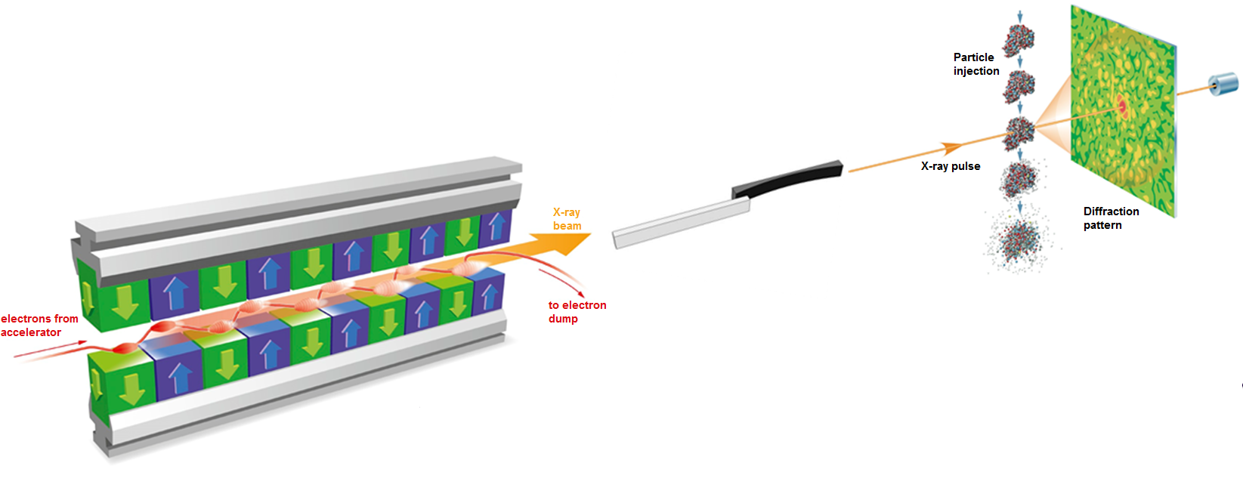
Single particle imaging simulation workflow
Diffraction signal generation
pysingfel
Photon Propagation
WPG/SRW
Wavefront database API
Photon Source
FAST-XPD database
Detector
Poisson noise
Real detector noise
Photon-matter Interaction
XMDYN
GROMACS
Data analysis
R-factor
EMC orientation
Phase retrieval
… more
Notes:
We take single particle imaging as an example here, to show how we make use of the start-to-end simulation, to help identify the optimal parameters. We first retrieve the photon source data from the xxx. This database is maintained at European XFEL. Then the photons are propagated through the SPB/SFX instrument optics. This part is finished by this WPG code maintained by Liuba’s group, also from European XFEL. We also considering developing a wavefront database to collect the data from typical optics setups. Because this kind of wave propagation simulation requires an expertise to run a reliable simulation. It will be difficult for the normal users to run the simulation themselve. Then they can explore the parameters they are interested in in the downsteams. Gromacs is a popular molecular dynamics tool for biomolecules. We now often implement the simple poisson noise model in our simulation. But we also trying to implement the real detector noise in our simulation. For example to make use of the AGIPD flat field measurements, to extract some information from it and implement that in the simulation data.

Slide 13
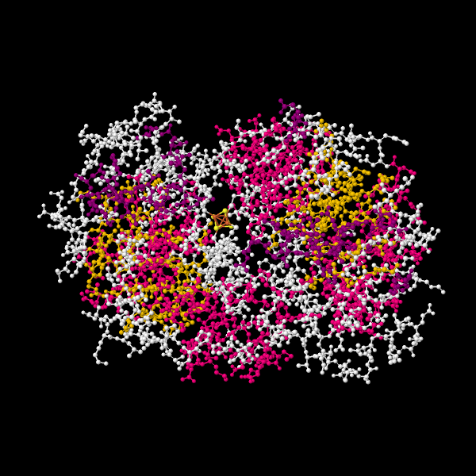
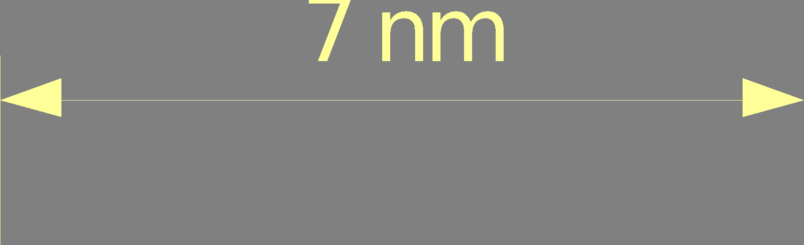
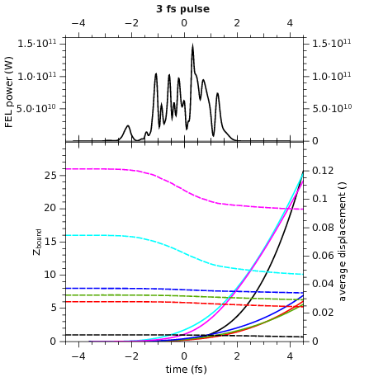
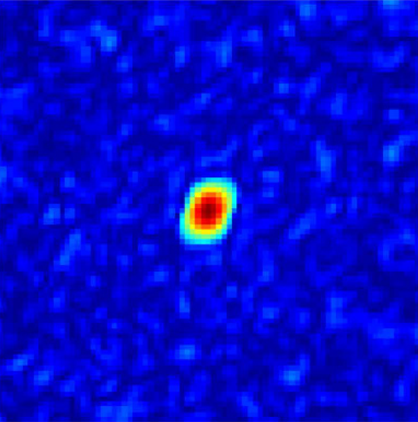
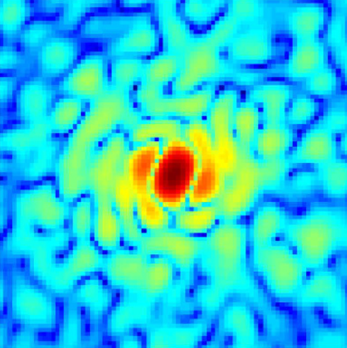
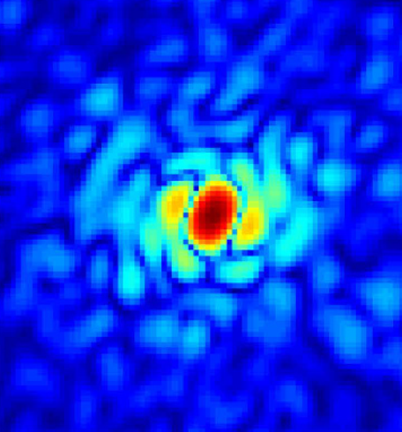
Identify optimal pulse duration for single particle imaging of a biomolecule
FEL Source
Pulse duration 3 fs, 9 fs, 30 fs
Photon energy 4.96 keV
Sample
Two-nitrogenase protein (2NIP)
~5000 non-H atoms
Iron-Sulfur ligand “SF4”
Known crystallographic structure
Beamline optics
Pair of offset mirrors
KB nano-focussing
Mirror height profiles included
Simulation
40 pulses from FAST XFEL Pulse Database
Propagation: WPG (SPB-SFX beamline)
PMI: ~1000 Sample trajectories 100 snapshots per trajectory
Apply random rotation of atom coordinates to each trajectory
200 diffraction patterns per trajectory
→ 200000 patterns
sample molecule 2NIP
Schlessman et al. J. Mol. Biology (1998)
Signal Generation
Photon Propagation
Photon Source
FEL power (W)
Photon-matter Interaction
# bound electrons
Fortmann-Grote, C. et al., IUCrJ 4, 560–568 (2017)
Yoon et al. Scientific Reports 6 24791 (2016)
Notes:
The first application case is to identify the optimal pulse duration for single particle imaging. We have chosen three different pulse durations to get it’s radiation damage information and about 200,000 diffraction patterns
‹#›

Slide 14
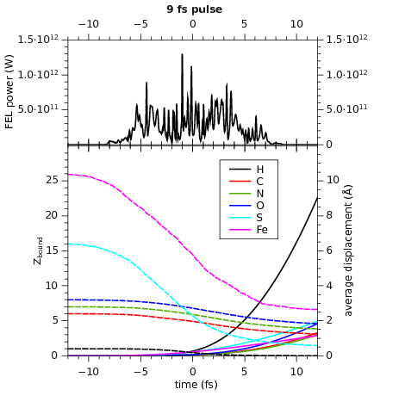
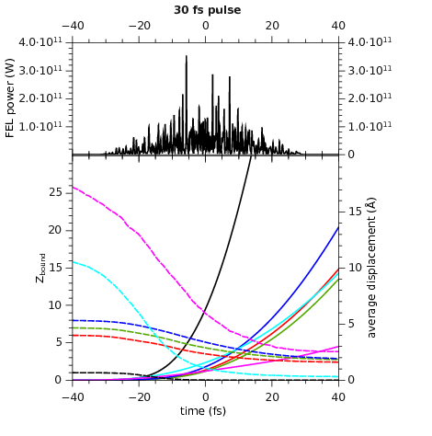
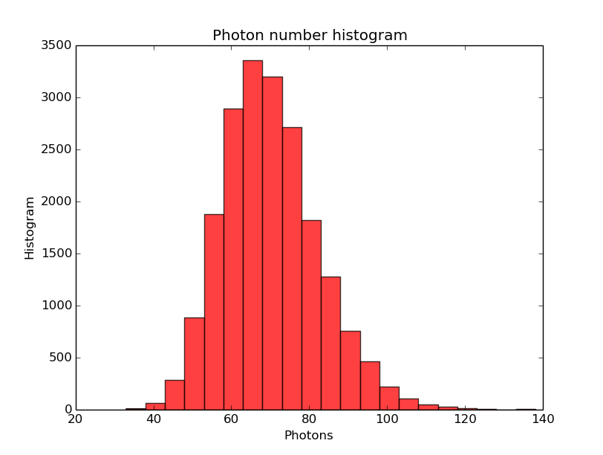
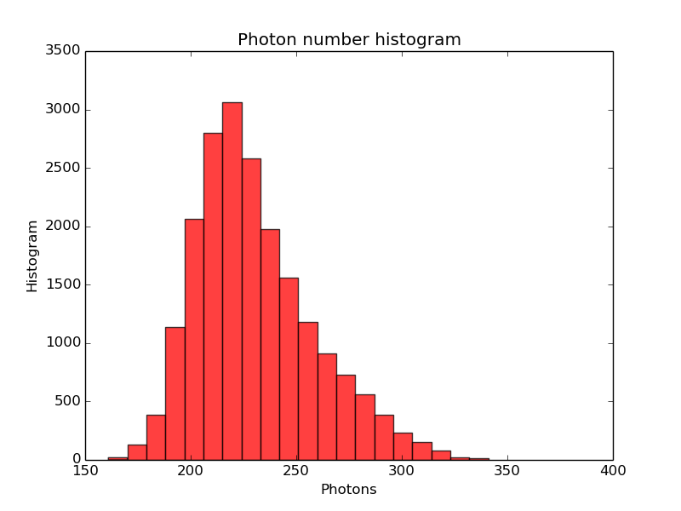
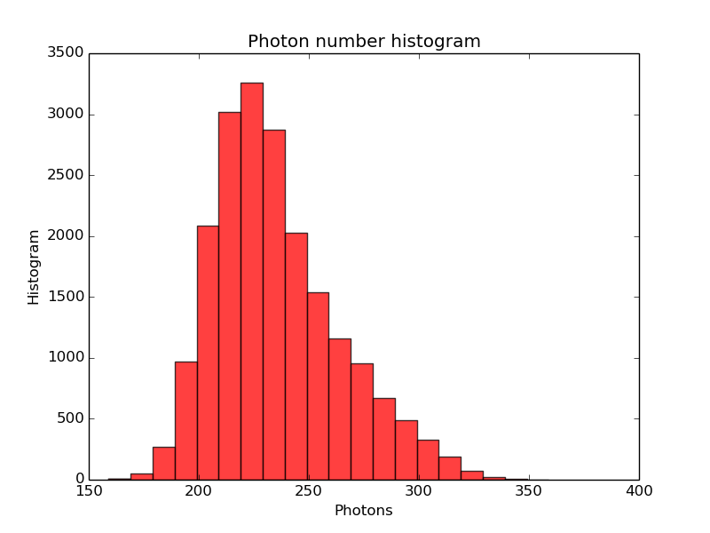
Identify optimal pulse duration for single particle imaging of a biomolecule
photons per pulse = 1·10¹¹ 5·10¹¹ 1·10¹²
3 fs
9 fs
30 fs
FEL power (W)
avg. displacement (Å)
# bound electrons
time (fs)
diffracted photons = 70+/-12 230+/-28 234+/-29
Fortmann-Grote, C. et al., IUCrJ 4, 560–568 (2017)
Yoon et al. Scientific Reports 6 24791 (2016)
Notes:
‹#›
You cannot enhance the sinal-to-noise ratio by simply extending the pulse duration. Besides the photon-matter interaction

Slide 15
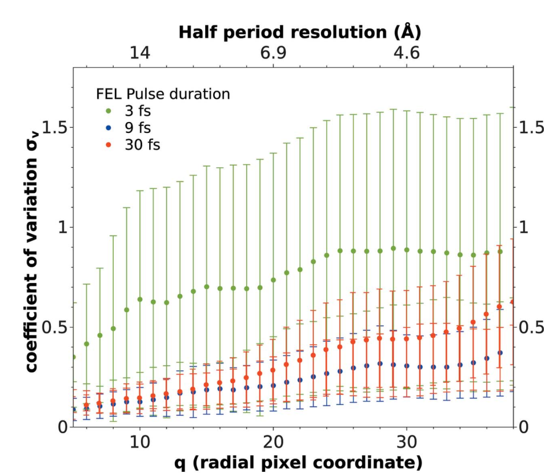
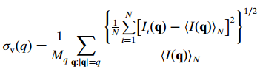
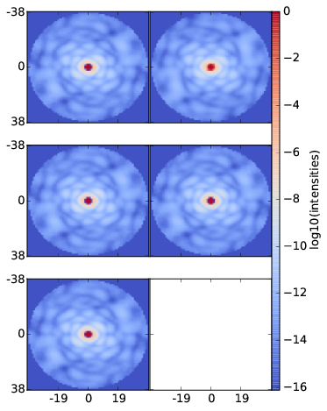
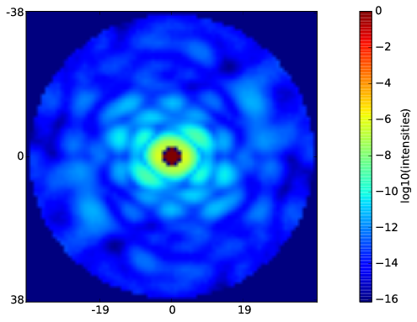
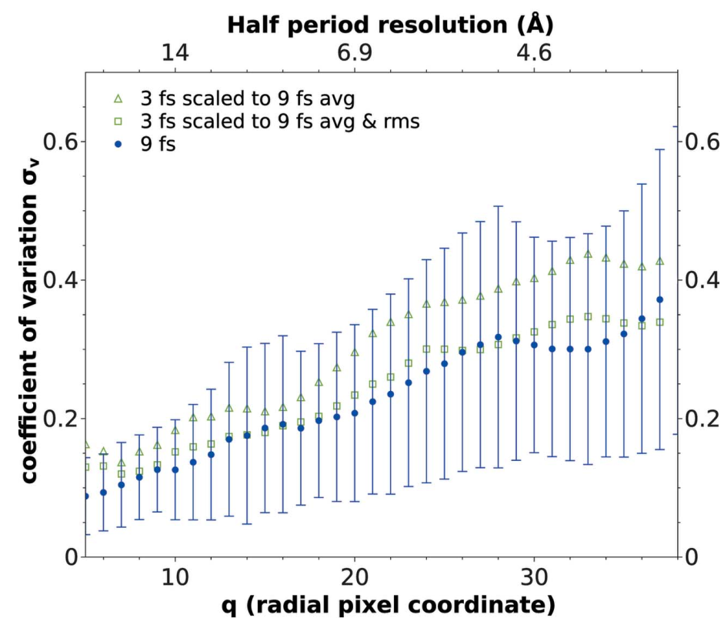
Identify optimal pulse duration for single particle imaging of a biomolecule
5 independent orientation runs
Average, r.m.s
r.m.s is the error bar
Fortmann-Grote, C. et al., IUCrJ 4, 560–568 (2017)
Yoon et al. Scientific Reports 6 24791 (2016)
Notes:
‹#›
The coefficient variation for different pulse durations

Slide 16
Identify optimal pulse duration for single particle imaging of a biomolecule
Conclusions:
Over the half-period resolution range (3-15 Å), the optimal pulse duration is close to 9 fs.
For 30 fs pulses, the impact of radiation damage is too large.
Although shorter pulses mitigate radiation damage (ionization), 3 fs pulses contain too few photons to allow enough photon statistics and consistent orientation of diffraction patterns.
Fortmann-Grote, C. et al., IUCrJ 4, 560–568 (2017)
Yoon et al. Scientific Reports 6 24791 (2016)
Notes:
‹#›

Slide 17
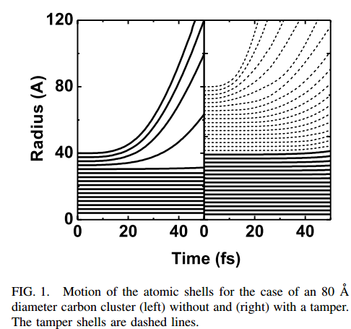
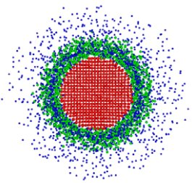
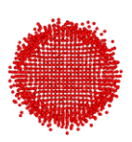
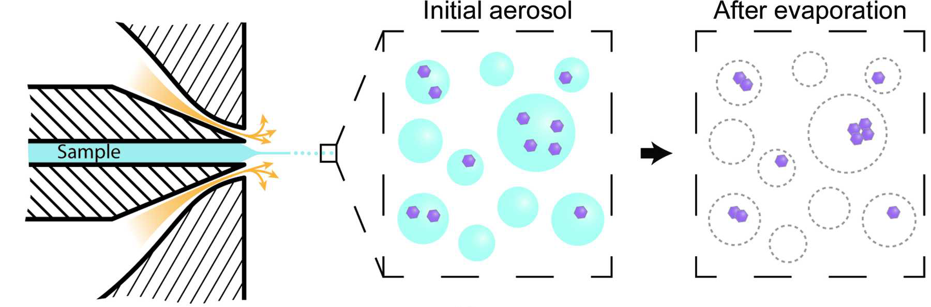
Single-particle imaging of hydrated proteins with an X-ray Free-Electron Laser
The tampering effect of water layers
Motion of the atomic shells for the case of an 80 Å diameter carbon cluster (left) without and (right) with a tamper. The tamper shells are dashed lines
w/o water layer
w/ water layer
Signal Generation
Photon Propagation
What is the optimal tamper layer thickness to successfully orient or phase the data?
Photon Source
Photon-matter Interaction
J. C. E, M. Stransky, et al., in preparation
Jurek, Z. & Faigel, G., Eur. Phys. J. D 50, 35–43 (2008)
Daurer et al., IUCrJ 4, 251 (2017)
Notes:
The second example is about hydrated proteins. The water layer around sample is very typical in bio-molecular experiments. In the case of single particle imaging, the water layer on the one hand can act as a tampering layer to protect the protein sample from the radiation damage, but on the other hand, the water layer itself is a source of diffraction background. So based on this tradeoff, we would like ask what is the optimal tamper layer thickness to successfully do the orientation and phase reconstruction?

Slide 18
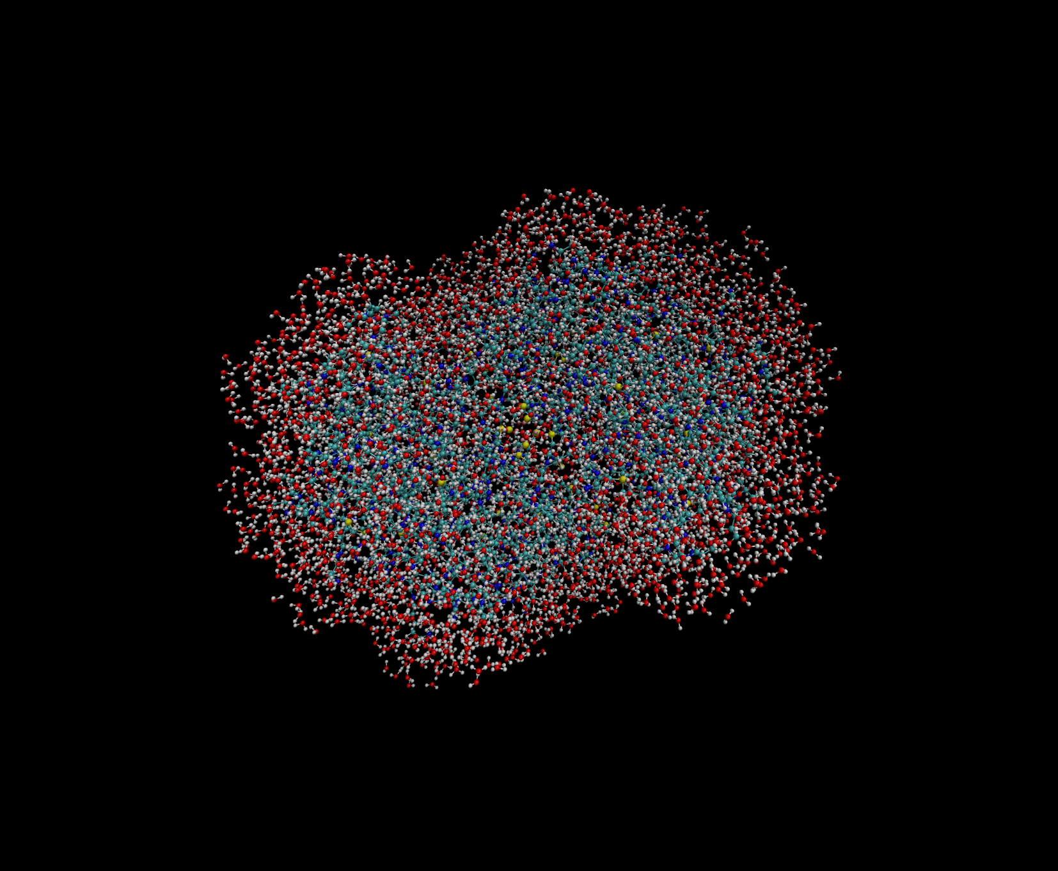
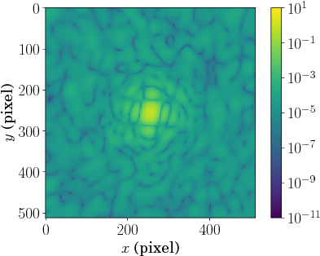
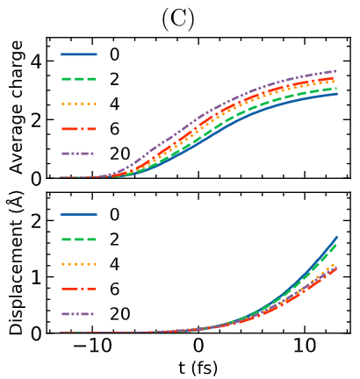
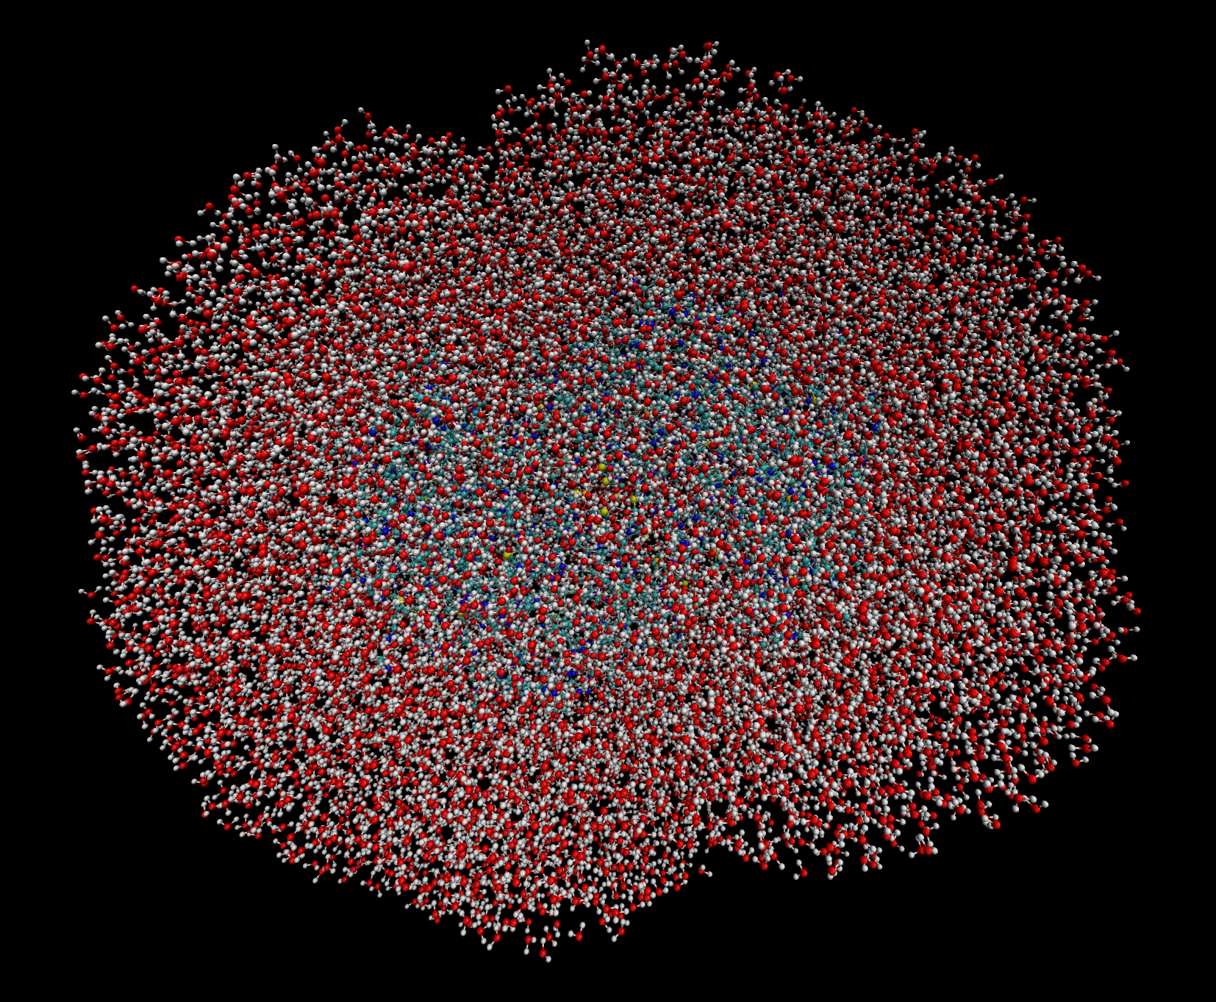
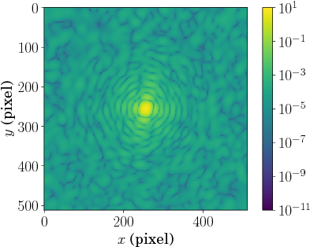
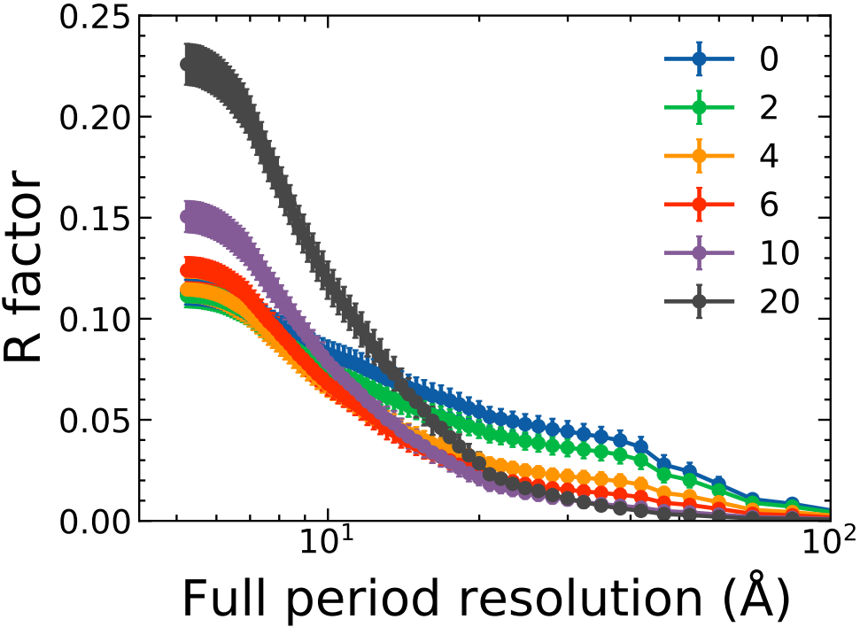
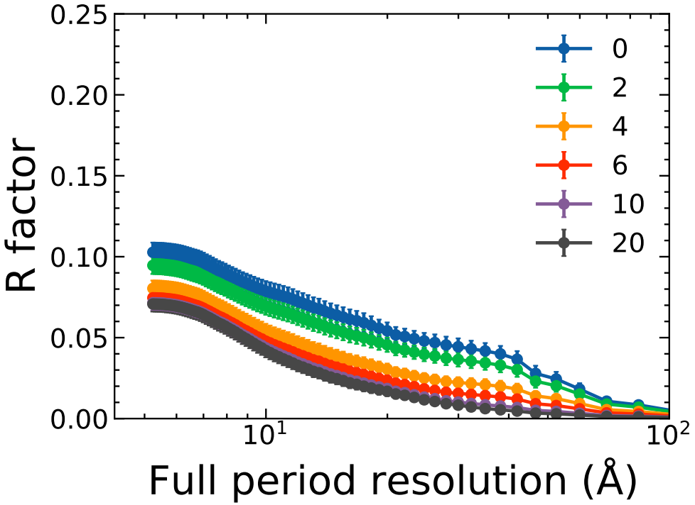
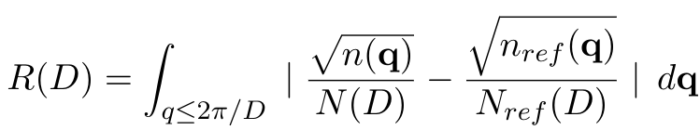
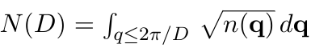
Single-particle imaging of hydrated proteins with an X-ray Free-Electron Laser
FWHM= 9 fs
Carbon in 2NIP
6Å
20Å
Signal Generation
Photon Propagation
Photon Source
Inelastic (protein + water) + Elastic (protein)
Elastic (protein) only
Photon-matter Interaction
J. C. E, M. Stransky, et al., in preparation
Notes:
The preliminary conclusion is that if we can get rid of all the background, to have only the elastic scattering from the protein, the thicker water layer we have, the better. But in reality, is that it’s hard deconvolute the inelastic scattering from the protein and water, the water layer noise can reduce the quality at high resolution region. In that sense, a water layer below 6 A could be a good tradeoff.

Slide 19
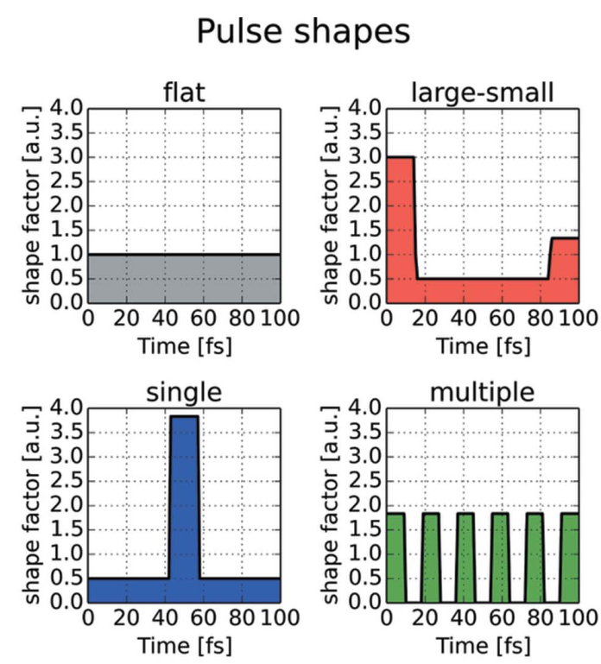
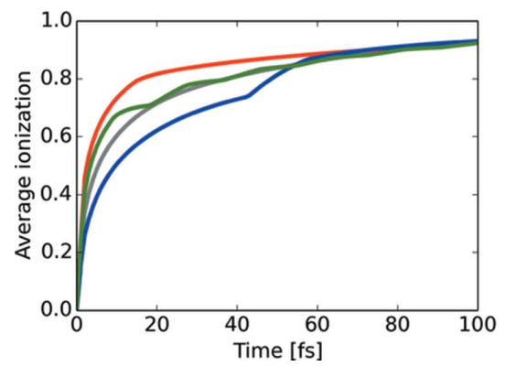
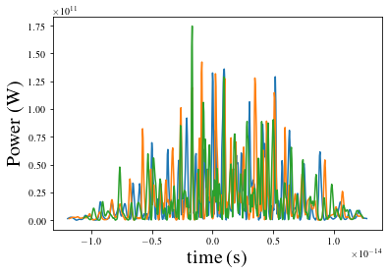
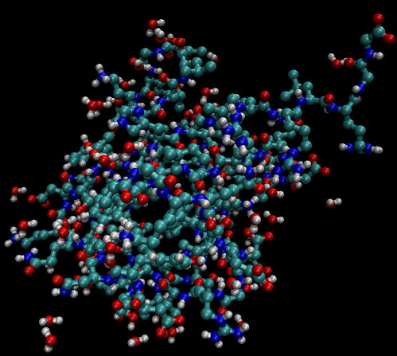
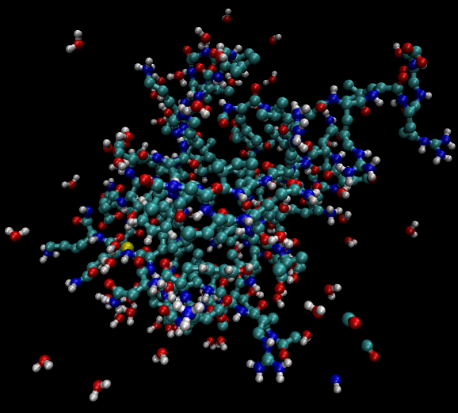
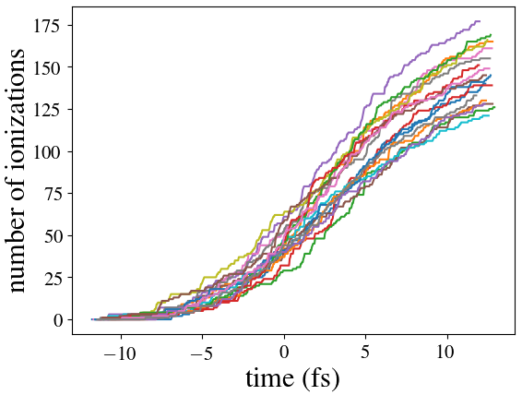
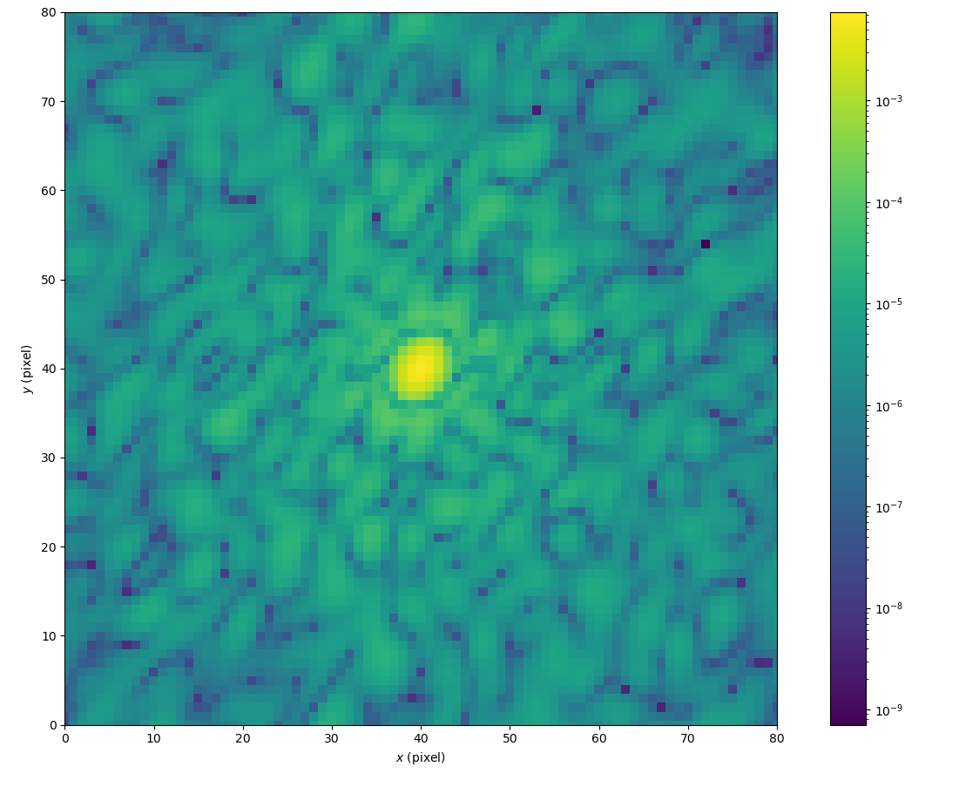
Pulse profile effects in single particle imaging
GROMACS calculator within SimEx API
How will the spiky SASE pulse affect the diffraction pattern quality and following orientation & phase reconstruction?
GROMACS calculator
Radiation damage in Ubiquitin
Diffraction patterns
SASE pulse temporal profile
Jönsson, H. O., Tîmneanu, N., Östlin, C., Scott, H. A. & Caleman, C., Journal of Synchrotron Radiation 22, 256–266 (2015)

Slide 20
Further work
Real detector behaviours
If the detector performance is not good enough, even if the sample and other instrumentation behaves well, the experiment still may not succeed.
Simulation result - XFEL source/beamline parameter feedback loop
Optimize the XFEL source/beamline parameters based on detector signal (e.g. diffraction pattern, spectrum) or reconstructed data (e.g. 3D orientation and phase reconstruction) quality.
AI training cases
Estimate XFEL spectrum from machine parameters with AI algorithm
Single particle imaging methodology understanding/optimization
Ascertain the smallest particle size practically visible in a single particle imaging experiment
… and more

Slide 21
Challenges
More user friendly code developments
Easy installation
Comprehensive documentations and examples
Encouraging more people to get involved
User expertise
Every step of start-to-end simulation requires corresponding knowledge to understand the assumption and limitation of the simulation method to be used
Simulation database could be a solution
SimEx-Lite: https://github.com/PaNOSC-ViNYL/SimEx-Lite
Under development
juncheng.e@xfel.eu

Slide 22
Conclusions
A simulation framework for photon experiment is under continuing development
It includes clear standards for data at different steps
Efforts are taken to make it more user friendly (documents, lite version, ... )
Open to further contributors
Such simulations offer the potential to more efficiently, or better, use beamtime with:
Optimised source parameters
Analysis algorithms (including AI) tested and optimised on simulated data
Narrow parameter space for experimental conditions (e.g. optimal water layer in SPI)
Optimal design of instrumentation for future experiment stations or configurations.
Two simulations for SPI at SPB/SFX at European XFEL to include:
XFEL SASE pulses with various pulse length
X-ray wave propagation through the instrument
A variety of thicknesses of the water layer surrounding the particle
Radiation damage induced by photon-matter interaction
Orientation reconstruction quality evaluation
More possibilities in further work (real detector behaviours, parameter feedback loop, AI training)

Slide 23










Acknowledgements
Adrian Mancuso, Carsten Fortmann-Grote, Michal Stransky, Chan Kim, Thomas Kluyver, Yoonhee Kim, Raphaël de Wijn, Marcin Sikorski, Johan Bielecki, Henry Kirkwood, Liuba Samoylova, Alexey Buzmakov, Juncheng E
Chuck Yoon, Christopher Mayes, Jacek Krzywinski, Hugo Slepicka, Paul Fuoss
Oleg Chubar, Maksim Raktin
Beata Ziaja-Motyka, Zoltan Jurek
Axel Huebl
Ibrahim Dawod, Carl Caleman, Nicusor Timneanu
Aljosa Hafner (CERIC-ERIC), Mads Bertelsen (ESS), Mousumi Upadhyay Kahaly , Zsolt Lecz (ELI-HU), Shervin Nourbakhsh (ILL), Manuel Sanchez del Rio (ESRF)
Shen Zhou, Duane Loh
This project has received funding from the European Union's Horizon 2020 research and innovation programme under grant agreement No. 823852

Slide 24
Links & References
juncheng.e@xfel.eu
Links
SimEx: https://github.com/PaNOSC-ViNYL/SimEx
SimEx-Lite: https://github.com/PaNOSC-ViNYL/SimEx-Lite
SimEx Documentation: https://simex.readthedocs.io/en/latest/
SimEx Jupyter-notebooks: https://github.com/PaNOSC-ViNYL/SimEx-notebooks
openPMD: https://github.com/openPMD
NeXus: https://www.nexusformat.org/
PANOSC-ViNYL : https://github.com/PaNOSC-ViNYL/ViNYL-project
References
C. H. Yoon et al., Scientific Reports 6 24791 (2016)
C. Fortmann-Grote et al., IUCrJ 4, 560–568 (2017)
C. Fortmann-Grote et al., in Advances in Computational Methods for X-Ray Optics IV vol. 10388 103880M. doi: 10.1117/12.2275274
J. C. E et al., in Advances in Computational Methods for X-Ray Optics V (eds. Sawhney, K. & Chubar, O.) 33 (SPIE, 2020). doi:10.1117/12.2570378
J. C. E et al., in preparation

